Slide 1

"Unlocking Insights: Harnessing Web Scraping for Data Analysis"
Amandeep Singh
Email- amandeep.1.singh@kcl.ac.uk
March 2024

Slide 2
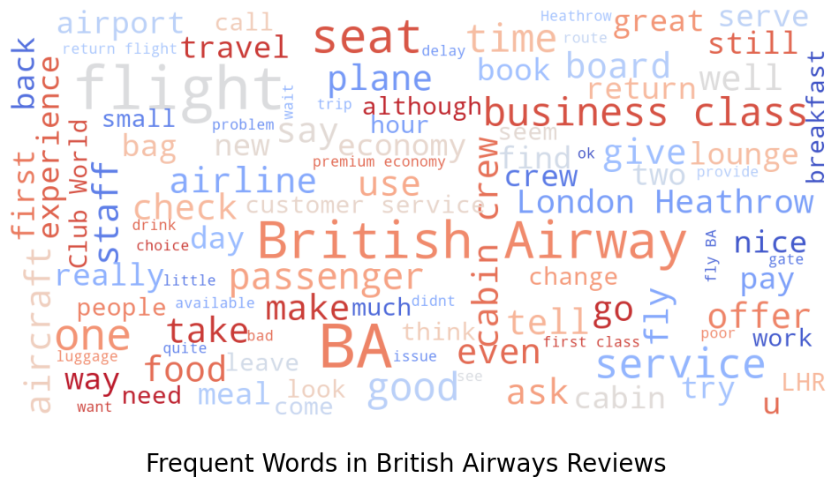
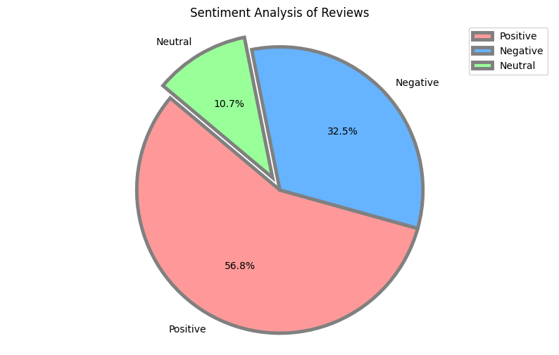
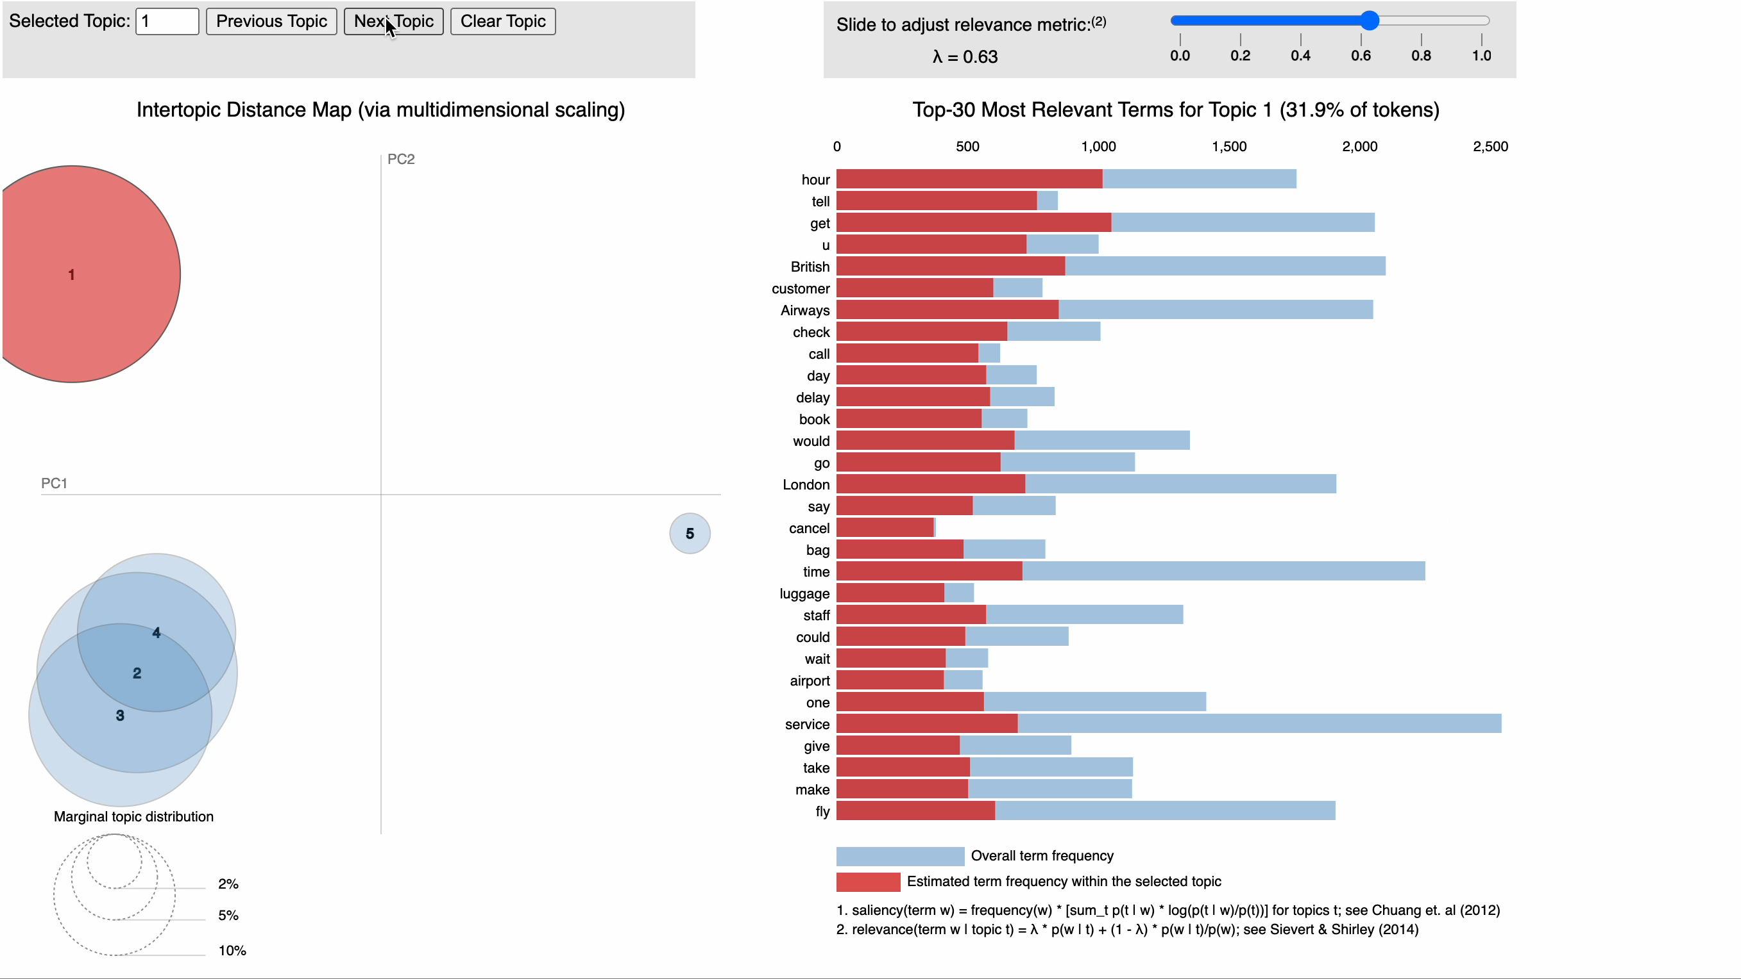
Customer Reviews Analysis
Total reviews analyzed: 3763
Positive reviews: 2136
Negative reviews: 1222
Neutral reviews: 405
Interactive topic model visualization

